Slide 1
Division of Procurement & Contract Services
Josh Dubroff, Chief Procurement Officer

Slide 2
Who are we?
Procurement Services
Contracts & Real Estate
Equipment Management
Administrative Coordination Team

Slide 3
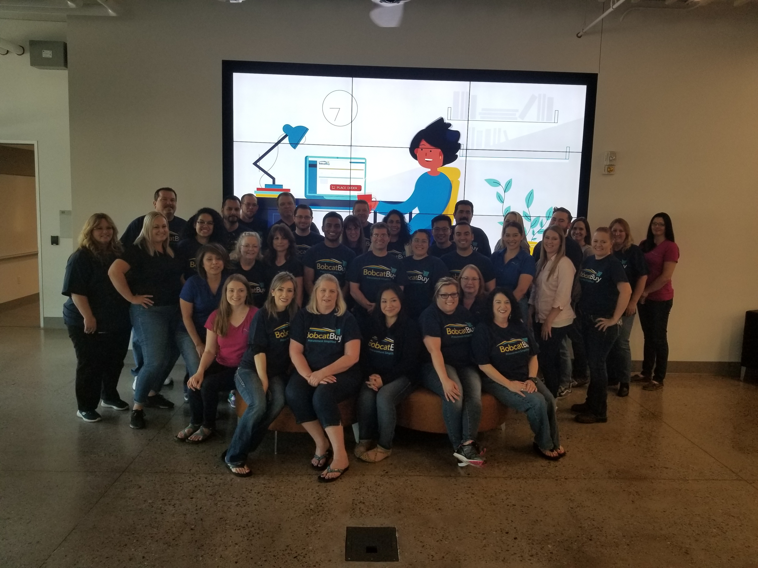

Slide 4
Common Focus Across Departments for…
  Service oriented/customer focused
  End-to-End process focus (total service)
  Effectiveness (How well are we meeting campus business needs)
  Efficiency (How well are we deploying limited resources to meet those needs)
  Continuous Improvement

Slide 5
Core Focus
Administrative Coordination Team
Equipment Management
Manage fixed assets lifecycle from purchase to disposal ensuring that University property is properly tracked and disposed of. Manage surplus program to maximize end of life value and CSR commitments
Procurement Services
Procurement Services Contracts & Real Estate
Negotiate and execute real estate, construction, non-purchasing related and high impact contracts. Provide support for complex procurements of goods and services to procurement team.
The Administrative Coordination Team provides end-to-end process management for a variety of procurement, human resources and financial activities allowing departments to focus on their core activities while delivering maximum service to campus customers
Obtain the right goods & services, at the right time and in the right place at the best value to support research, teaching and public service while delivering a high level of customer service

Slide 6
Core Activities
Procurement Services
Manage high impact and non-purchasing related contracts
Equipment Management
Track and report for fixed assets lifecycle
Track and report for export controlled and other unique items requiring tracking
Manage surplus program (Reduce, Reuse, Recycle)
Contracts & Real Estate
Administrative Coordination Team
Category Management & Strategic Sourcing
Process Improvement
Partnership with Campus Stakeholders
Manage supplier database
Support for procurement with challenging or unique procurements
Audit and compliance programs management & reporting
Supply chain solutions
Benefit generation
Support campus CSR activities related to equipment management & reporting
Spend Analysis
Procurement
Personnel
Travel & Entertainment
Finance
Customer support, service desk (Bobcat Buy), process guidance

Slide 7
Organized to maximize value!
  Procurement Services
    Strategic Sourcing and Special Projects
    Procurement Operations
    Analytics & Reporting
    Customer Success & Training
  Contracts & Real Estate
    Construction & Real Estate Focus
    Solutions, Partnerships, Revenue, Unique Services and Other focus
  Equipment Management
    Asset Management
    Surplus Operations
  Administrative Coordination Team
    BLUE Team: Office of Research & Economic Development/Facilities
    Green Team: Office of the Chancellor/School of Social Sciences, Humanities & Arts/ Part of Division of Physical Operations, Planning & Development
    Orange Team: Division of Financial & Administration-Provost/EVC

Slide 8
Meet our staff!
Procurement Services
Meagan Torres, Sr. Strategic Sourcing Manager
Todd Knittel, Procure-to-Pay Services Manager
Stephanie Zuniga, Customer Success & Training Manager
Todd Harris, Sr. Buyer
Kristi Morales, Buyer
Ken Masasso, Category Manager for Maintenance Repair & Operations (MRO)
Koy Saephanh, Category Manager for Life Sciences & Research
Vacant, Category Manager for Auxiliaries & Information Technology
Edmund Leung, Procurement Analyst
Contracts & Real Estate
Equipment Management
Vacant, Sr. Contracts Manager
Yasmeen Jewel, Construction Contract Manager
Vacant, Contract Administrator
Lori Callaway, Equipment and Surplus Manager

Slide 9
Meet our staff!
  Administrative Coordination Team
Blue Team
Business Officer-Cindy Roberts
Green Team
Business Officer - Diane Caton
Orange Team
Business Officer-Pam Taylor
Liaison- Kiyomi Not Help Him
Liaison-Desirea Monahan
Generalist – Xer Thao
Generalist- Destinee Lima
Generalist- Frankie Vasquez
Generalist- Joe Salmeri
Generalist – Laci Caetano
Generalist – Linda Wright
Generalist – Maria Higareda-Marquez
Generalist – Mary Larke
Generalist – Michele Amador
Liaison- Atalie Womble
Liaison - Sherry Ward
Generalist – Tracey Aue
Generalist- Sarah Anderson
Generalist- Laura Purkey
Generalist- Iyari Ortiz
Generalist – Heather Sanchez
Generalist – Gabriel Hornbuckle
Liaison-Carla Hunt
Liaison-Carmen Middleton
Liaison- Michelle Escalante
Generalist- Ian Cooke
Generalist- Elias Vargas
Generalist- Robert Gilbert
Generalist – Tessa Easley
Generalist – Brandon Middlecamp

Slide 10

Recent Accomplishments
Procurements image has been transformed from the department of “no” to “how can we partner with you to meet your business needs”
More than 500% increase in annual cost savings in 2 years
ACT has assigned staff to other departments for support during vacancies
ACT has met their service levels more than 97% of the time
ACT has expanded to cover more than 50% of campus departments

Slide 11
Projects & Initiatives
  2020 Related Procurements
  Transition to strategic sourcing and supply chain management
  Supply Chain Modernization Initiative
    End-to-End process integration
    Procurement. Simplified.
  Growth in consolidated services
  GL Implementation related to supply chain functions
  Staff training and development
    Program for ACT
    CPSM Training for all Procurement and Contracts Staff

Slide 12
What’s Next?
The procurement and contracts team is constantly evolving and improving how we do business with the goal of better serving the campus and our colleagues and delivering the maximum benefit to the campus through cost savings, cost avoidance and revenue generation.
Stay tuned for exciting updates coming soon!

Slide 13
Questions?

