Slide 1
Center of Institutional Effectiveness
(not “Excellence” or “for”)
Lunch & Learn Summer Series
August 14, 2019
CIE Management Team

Slide 2
Center of Institutional Effectiveness
Mission & Services
Mission (In Development)
We are a team of analysts with a wide array of responsibilities whose mission is to help the University thrive in the face of change. Our team focuses on empowering decision makers at all levels with long term, systemic solutions and believes that how we approach our work, with curiosity and rigor, is our hallmark for success.
Services
Our team loves challenging problems and helping others conquer them. As integrators and stewards of campus information, we participate in analyzing everything from the long range planning to the day to day management of our business systems.

Slide 3
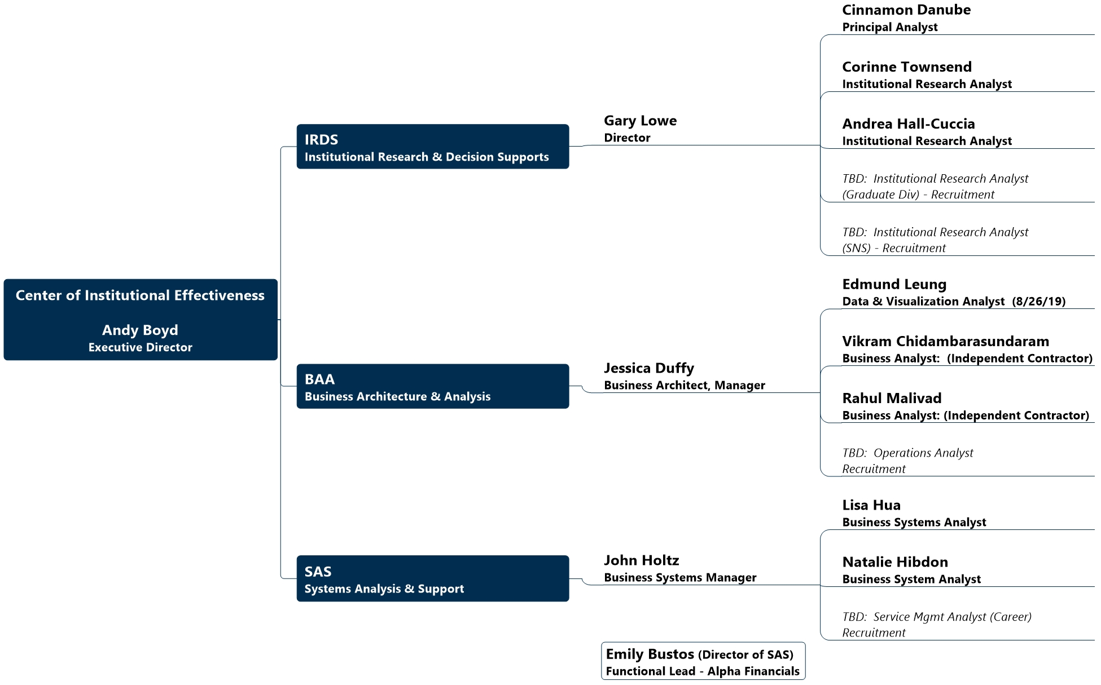
ORG Chart

Slide 4
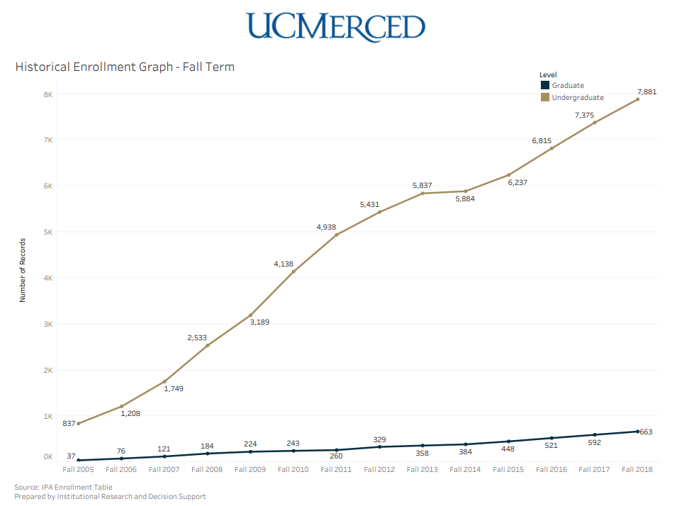
Institutional Research & Decision Support Services
IRDS provides consultation, reporting, and analysis for campus planning and decision-making to help advance the educational mission and effectiveness of the institution.
IRDS integrates, analyzes and reports on campus and external data to support campus information needs (e.g., official campus statistics) and comply with external reporting requirements (e.g., UC System, Federal). IRDS also provides statistical and methodological advice (e.g., survey development, program evaluation), conducts advanced analytics (e.g., predictive modeling), and manages institutional surveys.
IRDS analysts have expertise in a range of areas, including but not limited to: admissions, enrollment management, student success, faculty workload, resource allocation, and long range planning.

Slide 5
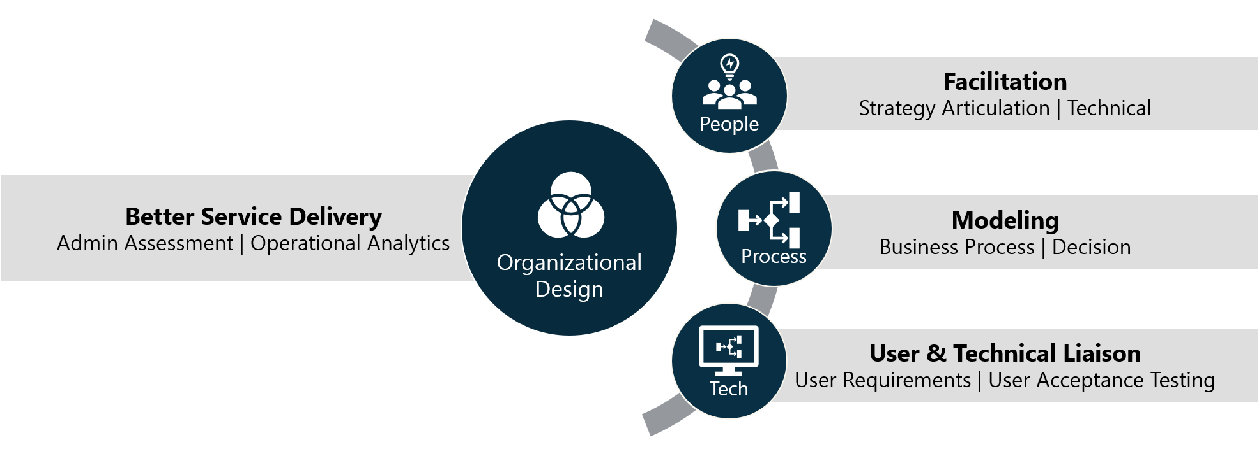
Business Architecture & Analytics Services
Empowering People to Deliver Better Service through Aligned Process and Technology
Business Architecture
Business Analysis
Data Visualization
  Understanding the campus-level needs and the relationship between functional areas in respect to the overall institutional strategies
  Partnering to understand what functions need to get their work done, capturing it in a way that can be used to build a better process or tool
  Partnering to find insights on service performance through meaningful metrics and storytelling through data visualizations

Slide 6
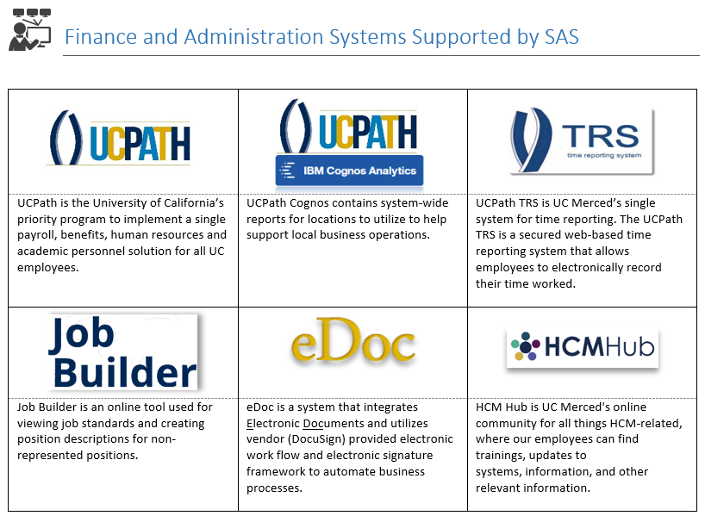
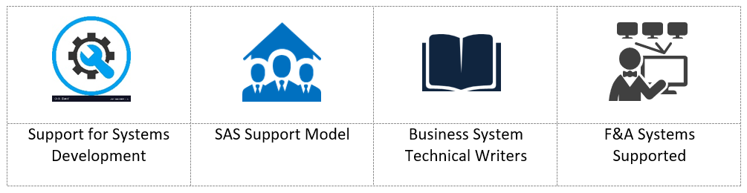
SAS Services
System Analysis & Support (SAS) consists of Business Systems Analyst who acts as intermediaries between business functions and information technology (IT). We have extensive knowledge of business operations as well as an understanding of technology and bridge the gap with business systems support. Our primary focus is supporting Finance and Administration (F&A) Systems.

Slide 7
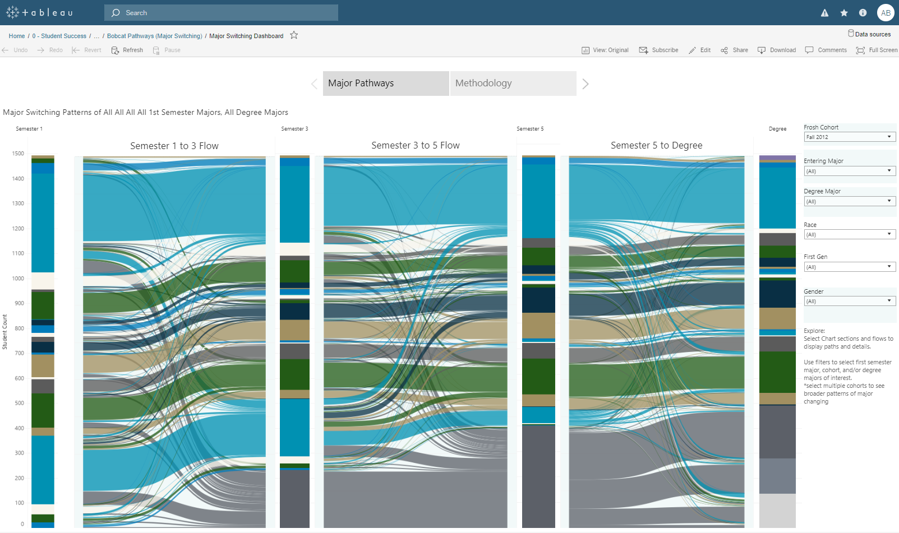
Major Initiatives & Projects
CIE Initiatives
Analytics Hub – Tableau
Analytics Roadmap
Long Range Planning and Modeling
Business Process Documentation
Functional Service Management
Initiatives Collaboration
Alpha Financials
Sponsored Project Redesign
WFA

